Slide 1
Disk I/O

Slide 2
What about storage?
dependability instead of performance
storage capacity
plan for expandability
diversity of devices
performance is important too
dependability, expandability and performance is affected by I/O devices, processor, system software

Slide 3
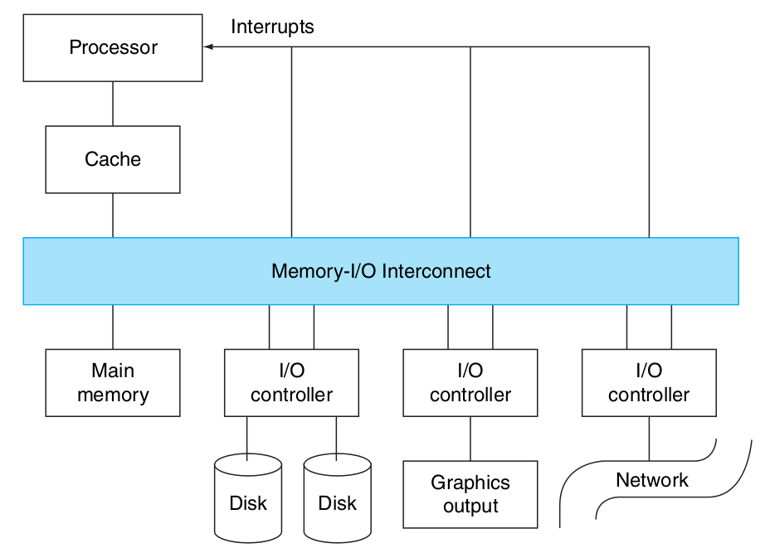
Show me…
connections between I/O devices, processor and memory called buses
which means shared parallel wires
today mostly dedicated serial lines
communication among devices and the processor uses both interrupts and protocols on the interconnect

Slide 4
I/O devices there are so many?
yes, incredibly diverse but three characteristics are useful in organizing this wide variety
behavior: input (read once), output (write only, not read), or storage (reread, rewritten)
partner: human or machine, either feeding data on input or reading data on output
data rate: peak rate data can be transferred between I/O and memory or processor

Slide 5
So, a keyboard is an input device…
a keyboard is an input device used by a human with a peak data rate of about 10 bytes per second
the graphics display is an output device used by a human with a peak data rate of about 8,000 Mbit/sec

Slide 6
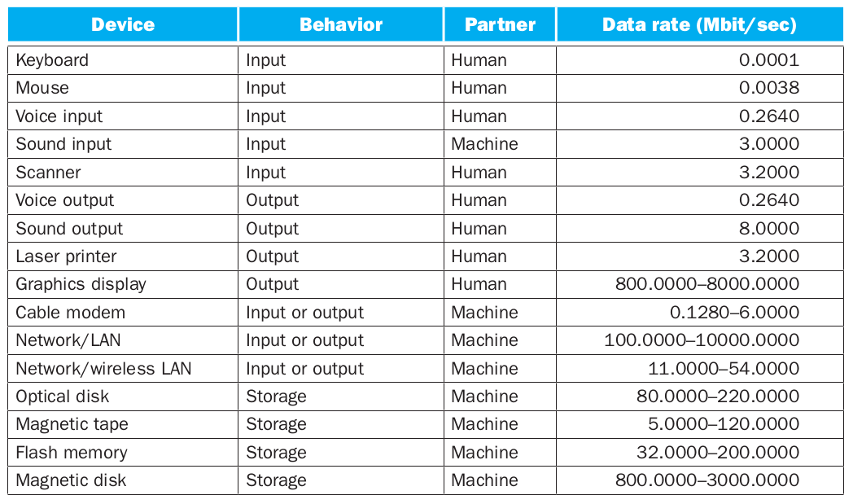
Do you have a list of all I/O devices?

Slide 7
A wide variety indeed…
yes, and that’s not a complete list
that’s why assessing performance is complex and it depends on the application
some environments care primarily about system throughput (large stream of data)
other environments response time is more important (desktop and laptops)
large I/O requests also depend on bandwidth

Slide 8
dependability of the I/O devices...?
reference specification of expected behavior
system alternating between two states
service accomplishment: delivered as specified
service interruption: different from specified
transitioning from state 1 to 2 caused by failures and state 2 to 1 are called restorations

Slide 9

How do we measure it?
reliability is a measure of the continuous service accomplishment from a reference point
mean time to failure (MTTF)
service interruption is measured as mean time to repair (MTTR)
availability measure of service accomplishment with respect to alternating between two states

Slide 10
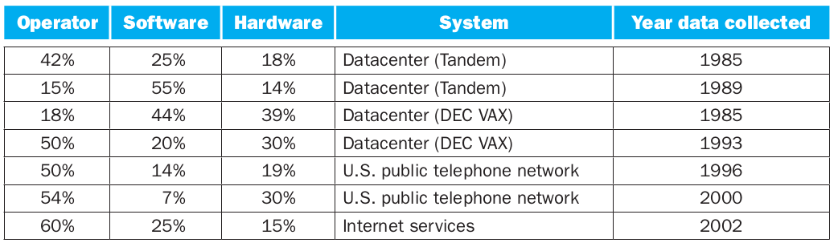
What is the cause of failures?
humans operators are a significant source of failures

Slide 11
How can we improve…?
Three ways to improve Mean Time To Failure (MTTF)
fault avoidance: preventing fault occurrence
fault tolerance: using redundancy
fault forecasting: predicting faults

Slide 12
Tell me more about I/O devices…
At least 3 categories that people think of devices in modern systems
Block devices: disk drives, tape, Cdrom
access blocks of data
commands open(), read(), write(), seek()
raw I/O or file system access
memory-mapped file access possible
Character devices: keyboards, mice, serial ports, some USB
single characters at a time
commands include get(), put()
libraries layered on top allow line editing
Network devices: ethernet, wireless, bluetooth
different enough from block/character to have own interface
unix and windows include socket interface

Slide 13
How user deal with timing?
Blocking Interface: “Wait”
when request data (e.g. read(), system call), put process to sleep until data is ready
when write data (e.g. write(), system call), put process to sleep until device is ready for data
Non-Blocking Interface: “Don’t Wait”
returns quickly from read or write request with count of bytes successfully transferred; read may return nothing, write may write nothing
Asynchronous Interface: “Tell Me Later” “Promise”
when request data, take pointer to user’s buffer, return immediately, later kernel fills buffer and notifies user
when send data, take pointer to user’s buffer, return immediately, later kernel takes data and notifies user

Slide 14
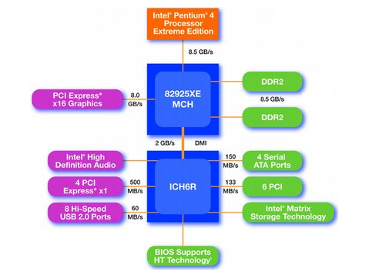
How I/O devices connect to processor?
old Intel Chipset Pentium 4
Northbridge (fast)
handles memory
graphics
Southbridge (slow)
PCI bus
disk controllers
USB controllers
audio
serial I/O
interrupt controller
timers

Slide 15
How does a processor actually talks to a device?
I/O instructions: x86
like load or store but rather than talking to memory address it talks to port addresses
read/write control registers on the device
in/out instructions
Memory mapped I/O: most popular since not all processor have I/O instructions
portions of address space assigned to I/O devices
I/O accomplished with load and store instructions
read and write to those addresses interpreted as I/O commands
registers/memory appear in physical address space

Slide 16
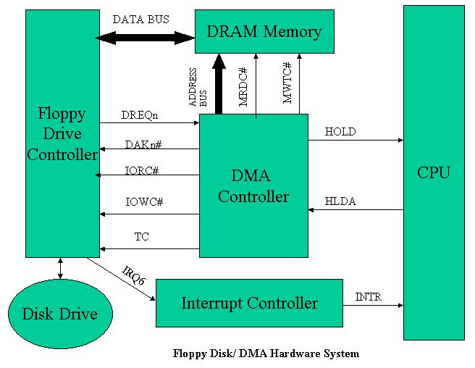
How its data moved to and from the device?
Programmed I/O: load, load, load, too much processor time
each byte transferred via processor in/out or load/store
simple hardware, easy to program
consumes processor cycles proportional to data size
Direct Memory Access (DMA): less processor heavy
give controller access to memory bus
ask it to transfer data to/from memory directly

Slide 17
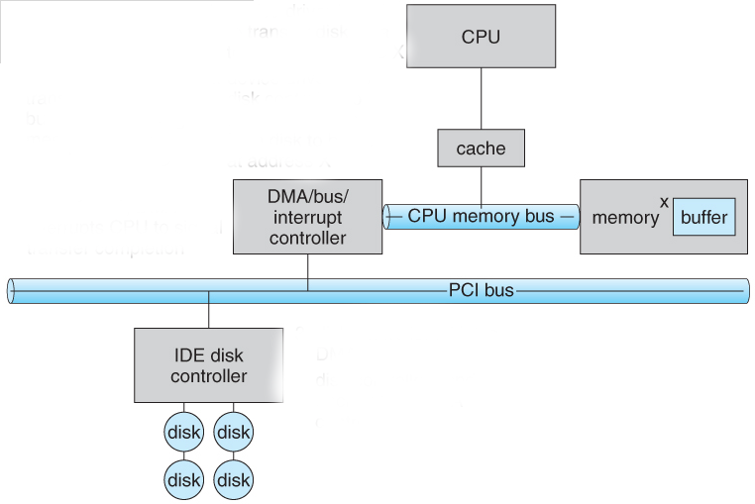
Show me…
1. device driver is told to transfer disk data to buffer at address X
2. device driver tells disk controller to transfer C bytes from disk to buffer address X
3. disk controller initiates DMA transfer
4. disk controller sends each byte to DMA controller
5. DMA controller transfers bytes to buffer X. increasing memory address and decreasing C until C = 0
6. when C = 0. DMA interrupts CPU to signal transfer completion

Slide 18
Yes, but how does it knows when its done?
the OS needs to know when device completes or encounters an error
I/O interrupts:
device generates an interrupt whenever it needs service
pro: handles unpredictable events well
con: interrupts relatively high overhead
Polling:
periodically checks a device-specific status register
I/O device puts completion information in status register
pro: low overhead
con: may waste many cycles on polling if infrequent or unpredictable I/O operations
actual devices combine both polling and interrupts. for instance, high bandwidth network device interrupt for first incoming packet polls until hardware empty

Slide 19
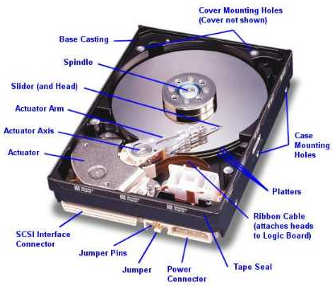
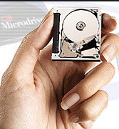
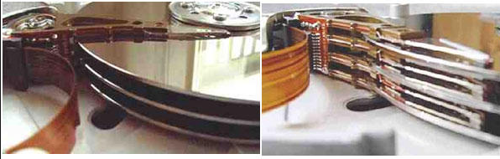
How about disk drives…?
IBM/Hitachi Microdrive
spinning disk drive
Read / Write Head Side View

Slide 20
hard disk drives, how are they attached to the computer?
via a cable, which is specific to the type of bus used
Integrated Drive Electronics IDE (aka Parallel AT Attachment PATA)
uses underlying ATA, ATAPI standards
Small Computer System Interface SCSI
standard defines commands, protocol for interfacing with storage devices
Serial ATA (SATA)
serial connector 7-pin with ATA or ATAPI
support faster transfers over the bus compared to PATA
Serial Attached SCSI (SAS)
SCSI protocol over a serial channel
faster transfers over the bus compared to parallel SCSI connections

Slide 21
how is data address on disk drives?
data is address by geometry
sectors smallest unit of data that can be addressed on a disk, historically 512 bytes
tracks circular paths at a constant radius from the center of the disk. each head reads from a single track at any given time
cylinders 3-dimensional structures formed by stacking tracks vertically (same track number on multiple platters)
here are some properties:
head moves in to address circular track of information
independently addressable element: sector
  OS always transfers groups of sectors together as “blocks”
items addressable without moving head: cylinder

Slide 22
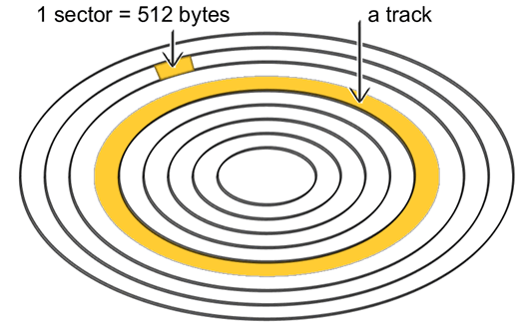
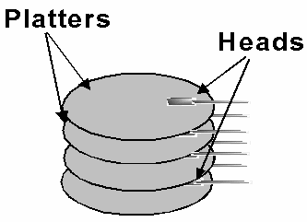
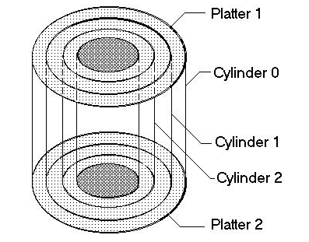
show me…

Slide 23
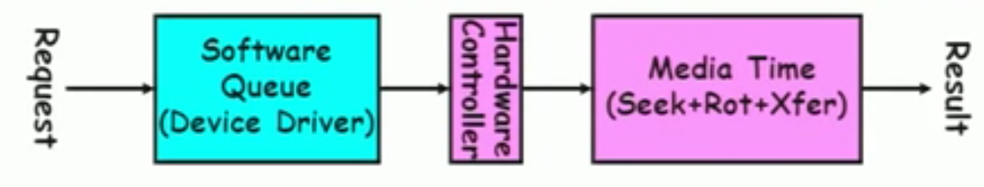
performance…
read/write data is a three-stage process
seek time: position the head/arm over the proper track (into proper cylinder)
rotational latency: wait for the desired sector to rotate under the read/write head
transfer time: transfer a block of bits (sector) under the read/write head

